Slide 1
Artificial Intelligence
Enrique Peláez Ph.D.

Slide 2
Agenda
  Machine Learning
    Genetic Algorithms
  Applications

Slide 3
Genetic Algorithms
Selection methods
  Scale selection: as the average aptitude of the population increases, the selection force also increases and the aptitude function is less discriminating.
  Tournament selection: subgroups of individuals are selected from the population and the members from each subgroup compete among them, only one individual from each group is selected for reproduction.
  Selection by range: a numeric range is assigned to each individual of the population based on its aptitude, and the selection is done from this ranking, instead of the absolute differences of the aptitude.
  Generational selection: descendents from the selected individuals in each generation become the next generation. Older generations are not kept…..

Slide 4
Genetic Algorithms
Exchange methods
  Once the suitable individuals have been selected, they have to randomly altered, with the hope of improving the aptitude value for the next generation.
  There are 2 basic strategies to do this: Mutation and Crossover.
  Just like in living beings, a mutation changes a gene for another, in genetic algorithms also a mutation causes small alterations of the code representing the individual, in specific concrete locations of that code.
  In crossover two individuals are selected to exchange segments of their code, producing artificial descendents who share a combination of their parent’s code.
  This process is similar to the sexual reproduction where a recombination of chromosomes is done.

Slide 5
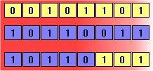

Genetic Algorithms
Exchange methods
Crossover
Mutation

Slide 6
Genetic Algorithms
Advantages of GA
  Parallelism
  GA explicitly evaluate a small number of individuals, but implicitly is evaluating a bigger group of individuals.
  GA can evaluate different groups of individuals, when selected as the more suitable individuals, and because of parallelism many schemas are evaluated at once.
  GA work fine solving problems where the solution space is really big, maybe too big, that making an exhaustive search in not practical.

Slide 7
Genetic Algorithms
Advantages of GA
  One of the main characteristic of a GA, which at first might look as a disaster, but actually is an advantage, is that they do not know anything about the problem they are solving.
  Instead of using specific information known beforehand to guide each step of the process, they make random changes to the candidate solutions and then use an aptitude function to determine if the changes made produce an improvement.
  The evolutionary algorithms are not aware of, or preoccupied for the beliefs or if a solution affects any established schema…. Just if it works better or not.

Slide 8
Genetic Algorithms
Limitations:
  To create a GA we need first to define a representation of the problem. The language used to specify the solution needs to be robust; capable of tolerating random changes that do not produce fatal errors or incoherent results.
  We need to code the individuals as a chain of symbols, letters or list of numbers -binary, integers or real- where each symbol represent some aspect of the solution.
  If the individuals are represented as a binary chain, a 0 or 1 means the presence or absence of some characteristic of the solution.
  If they are list of numbers, they can represent different things: Weights of the neural net connection, the order of the cities visited by a seller, the spatial position of an electronic component, the values to feed a controller, and so on...

Slide 9
Genetic Algorithms
Limitations:
  If the aptitude function is not well chosen or it has a deficient definition, the GA might not find a solution, or it might be solving a different problem.
  Also, the other parameters need to be carefully chosen, such as the size of the population, the mutation and crossover rhythm and the selection method.

Slide 10
Genetic Algorithms
Applications:
  Acoustics
  Airspace engineering
  Astronomy and astrophysics
  Chemistry
  Electrical engineering
  Financial markets
  Games
  Geophysics
  Material engineering
  Mathematics and Algorithms
  Army applications and law enforcement
  Molecular biology
  Pattern recognition and data mining
  Robotics
  Route design and scheduling
  Systems engineering

Slide 11
Genetic Algorithms

Slide 12
Genetic Algorithms
Example: Drawing a circle.
¿How can it be done, without specifying the center, radius or the formula for drawing a circle?

Slide 13
Genetic Algorithms
It can be done by simulating the evolution of a population of closed and simple curves using GA.

Slide 14



Genetic Algorithms
It can be done by simulating the evolution of a population of closed and simple curves using GA.

Slide 15
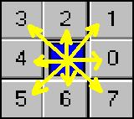
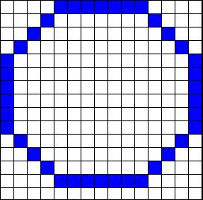

Genetic Algorithms
Chain code for the relative movement of a point in the curve to the following:
Example: The code for the following curve is:

Slide 16

Genetic Algorithms
Concept of a closed curve
A closed curve is a curve where all its points are adjacent to at least other 2 points of the curve.
Also, if we travel the chain code of the curve, at the end we reach the starting point of the curve.
This is not a closed curve!!!
The code is broken, then the curve is not closed.

Slide 17

Genetic Algorithms
A simple curve is a curve that all its points are adjacent to at most 2 points of the curve.
This point is adjacent to other 3 points in the curve, then this is not a simple curve.

Slide 18


Genetic Algorithms
Reproduction:
We take 2 individuals from the population and reproduce them.
Parent 2
Parent 1
Child

Slide 19



Genetic Algorithms
Crossover:
Take 2 individuals from the population and exchange part of their code. The new individual, descendent from the previous parents, share parts of the original individuals.
Original 2
Original 1
Crossover curve

Slide 20
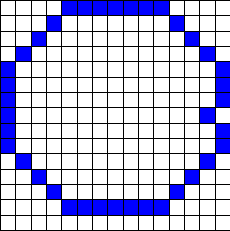
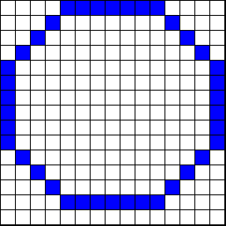
Genetic Algorithms
Mutation:
Produce a small change in the genetic code of an individual, looking to diversifying the population, with the hope that the evolution of the new individuals will met the objective function.
mutation

Slide 21
Projects
Project presentation
  Written report 10%
  Presentation 20%
  Content 40%
  Example 10%
  Q&A 20%
  TOTAL 100%

Slide 22
THANKS !!!!

